Slide 1

World Population
Data Analytics Project Prepared by
Naga
Komal Preet
Karishma
Amra
Population V/s Green

Slide 2
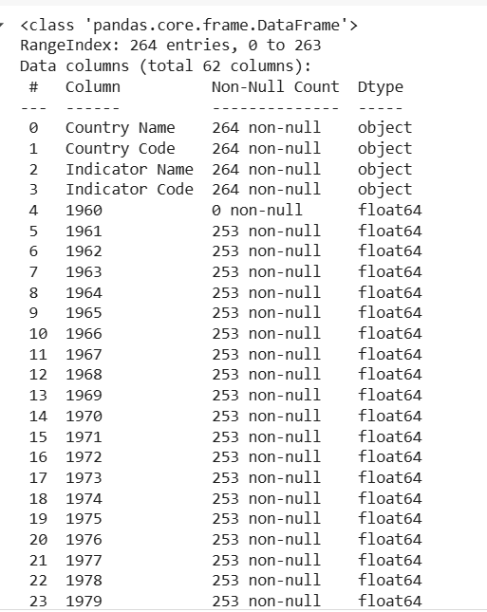
Dataset information: -
It has 263 rows and 62 columns.
Data type of the columns with object are under categorical.
Float type data columns are quantitative variables.

Slide 3
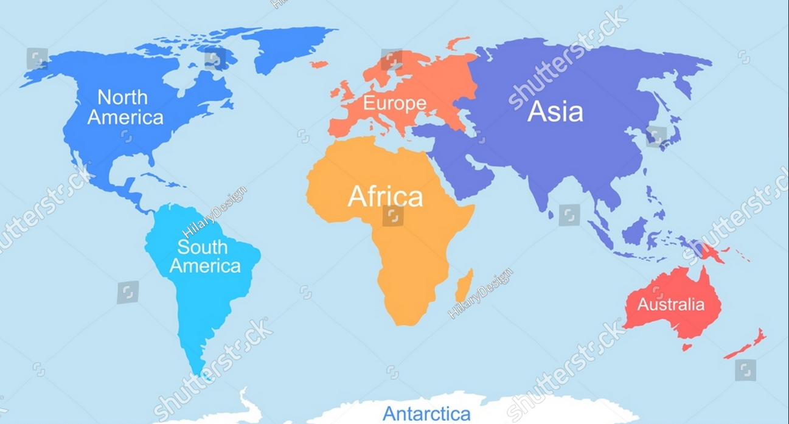
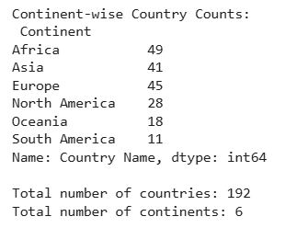
Number of Countries and Continents: -
Total no.of countries are 192.
Total no.of continents are 6.

Slide 4
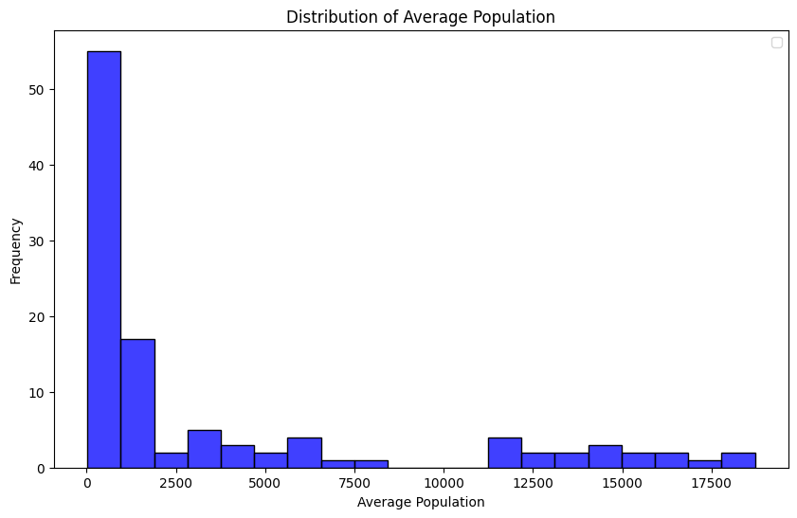
Average population: -
Below 0 - 2500 has highest Average population.
No population between 9000 – 10000.
At 17500 The average population is the least.

Slide 5
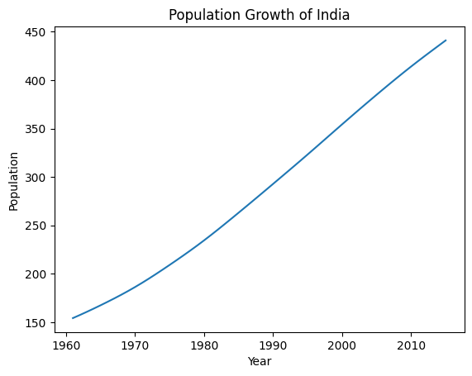
India population growth: -
India population has been increasing gradually from 1960 – 2010.
The population is high in the year 2010 and
In 1960 population trend was started.

Slide 6
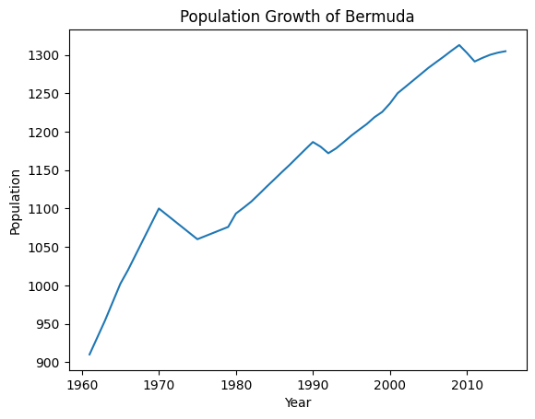
Bermuda population: -
Population increased in 1960 and highest population in 2010.
Increased till 1970 and decreased in 1975 and then increased continuously.
It is relating to year wise population of Bermuda country.

Slide 7
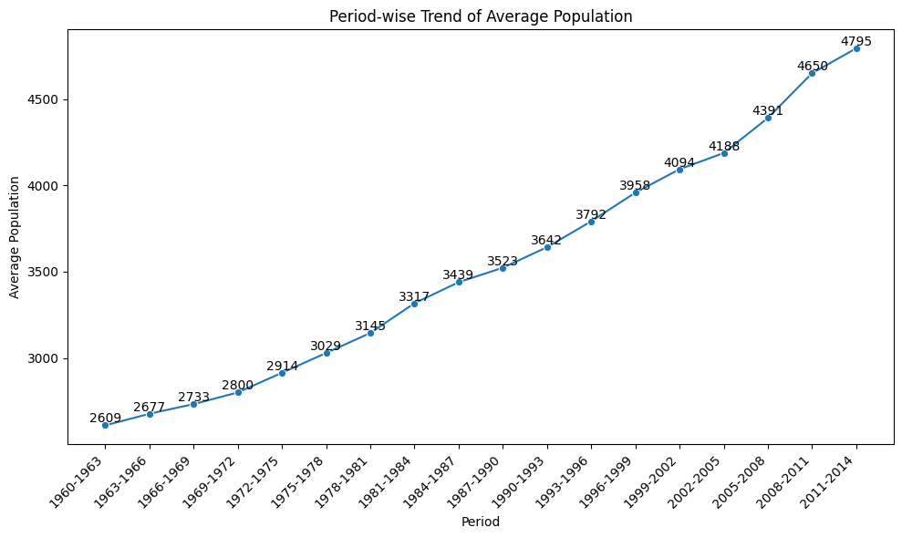
Period wise Average population Trend: -

Slide 8
Yearly Average population trend: -
Observations: -
During 1960 – 1963 the average population of all the countries is 2609 which has been doubled between 2011 – 2014.
Trend line shows the population is growing for every year continuously and strongly.
The changes in trend line, for increased population, is very small during (1981-1987,1999-2002 & 2008-2011) few periods.

Slide 9
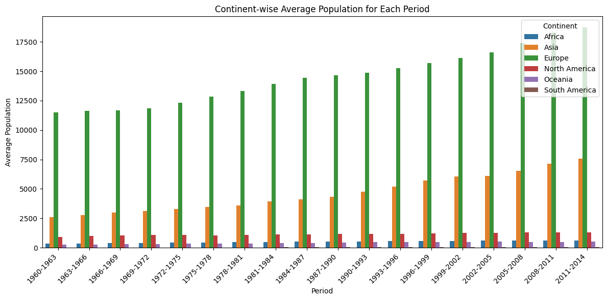
Continent wise average population for each period: -

Slide 10
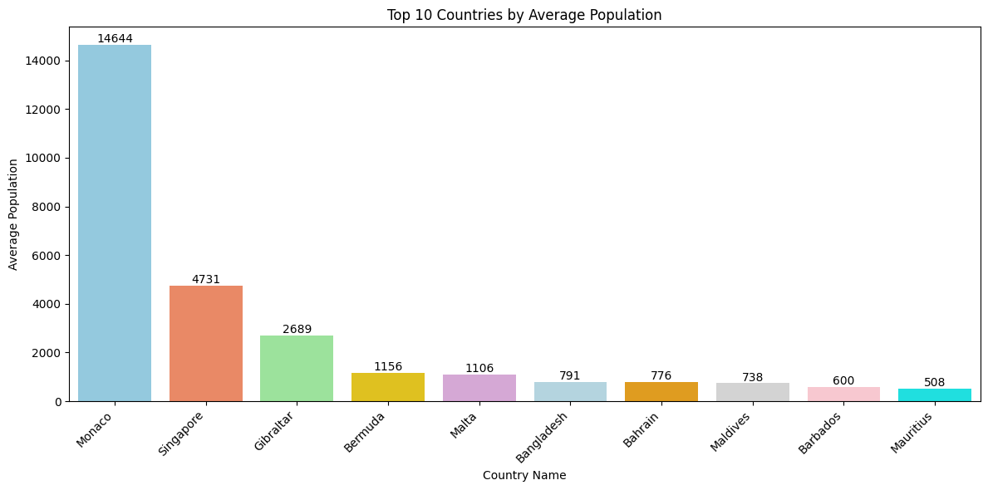
Country wise highest population: -

Slide 11
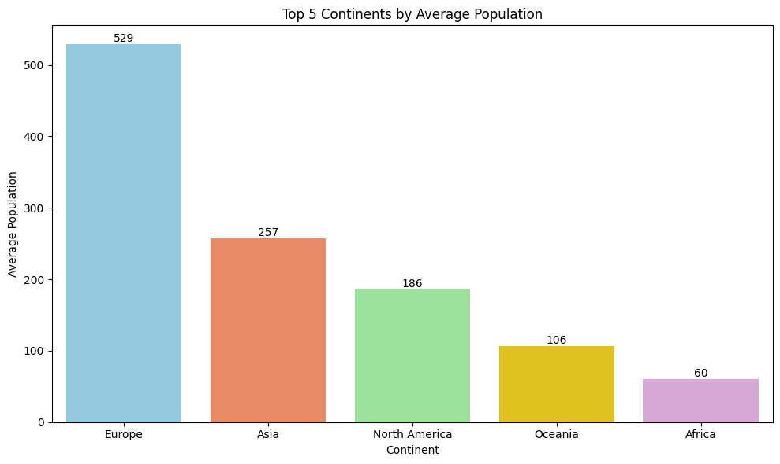
Continent wise highest population: -

Slide 12
Conclusion: -
Population has been growing gradually across the world.
Few country’s population increasing alone irrespective of the other countries population those are called outliers.
Continents consists the multiple countries so the results will be quite reverse.
END

